Slide 1

Flight Price Prediction
By
Gargi Saha Samanta

Slide 2

Content
Problem Statement
Data Summary
Data Preprocessing
Exploratory Data Analysis
Univariate Analysis of Categorical Variables and its observations
Bivariate Analysis of Categorical Variables and its observations
Univariate Analysis of Numerical Variables and its observations
Bivariate Analysis of Numerical Variables and its observations
Outliers
Feature Engineering
Model Building with Regression techniques
Hypertuning the Best Model
Conclusion

Slide 3
Problem Statement
Anyone who has booked a flight ticket knows how unexpectedly the prices vary. The cheapest available ticket on a given flight gets more and less expensive over time. This usually happens as an attempt to maximize revenue based on -
Time of purchase patterns (making sure last-minute purchases are expensive)
Keeping the flight as full as they want it (raising prices on a flight which is filling up in order to reduce sales and hold back inventory for those expensive last-minute expensive purchases) So, we have to work on a project where you collect data of flight fares with other features and work to make a model to predict fares of flights.

Slide 4

Data Summary
FEATURES:
Airline Name: The name of the airline.
Date_of_Journey: The date of the journey
Source: The source from which the service begins.
Destination: The destination where the service ends.
Dep_Time: The time when the journey starts from the source.
Arrival_Time: Time of arrival at the destination.
Duration: Total duration of the flight.
Total_stops: Total stops between the source and destination.
Price: The price of the ticket
Observation:
1. 8 Independent variables with Price as target variables.
2. From the dataset we can infer that it is clearly a regression problem.
3. The dataset consists of 1727 rows and 10 columns including one unnamed column which will be dropped later on.

Slide 5
Data Preprocessing
The dataset seems to have no null values in it.
Handling Departure_time.
Handling Arrival_time.
Handling Duration.
Handling Total_stops.
Treating the Date_of_Journey columns and make seperate columns.
Changing datatype to numerical columns as the data in it are numerical in nature but object type.

Slide 6

Exploratory Data Analysis ( EDA)

Slide 7
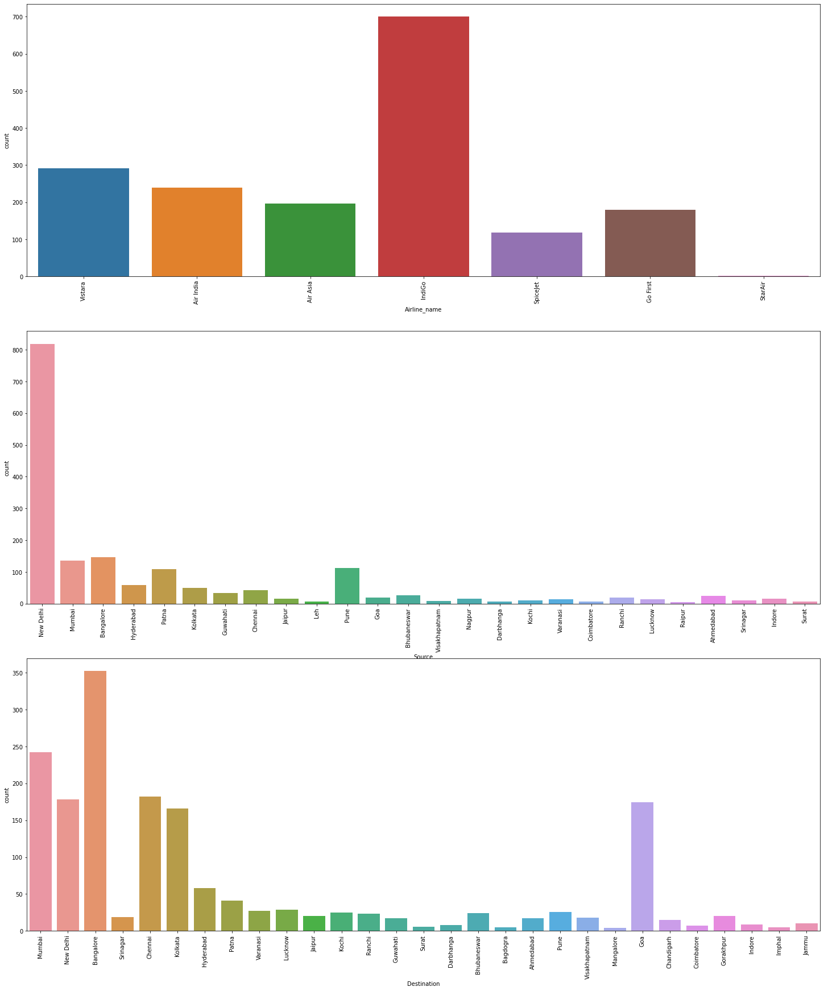
Univariate Analysis of categorical variables
Observation:
Highest no of flight recorded are Indigo followed by Vistara then Air India.
Most no.of flights are starting from New Delhi followed by Banglore then Mumbai and so on.
Most of the destination of flights are to Banglore followed by Mumbai,New Delhi, Chennai and so on.

Slide 8
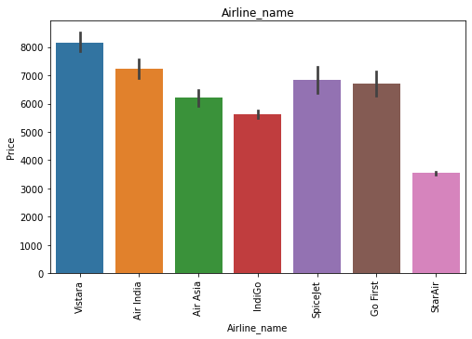
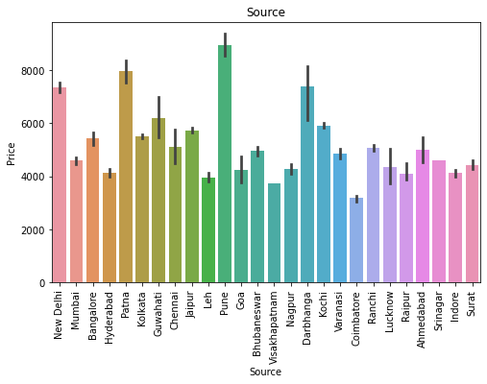
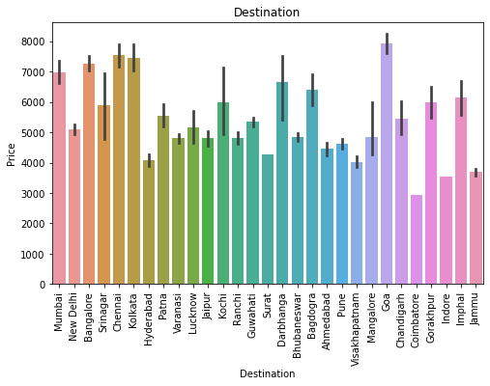
Bi-variate plotting of categorical variables
Observation in terms of Price:
Vistara flight having highest price as compared to others followed by AirIndia.
Flights originating from Pune followed by Patna and New Delhi.
Flights reaching Goa is having highest price followed by Chennai,Kolkata,Banglore and Mumbai.

Slide 9
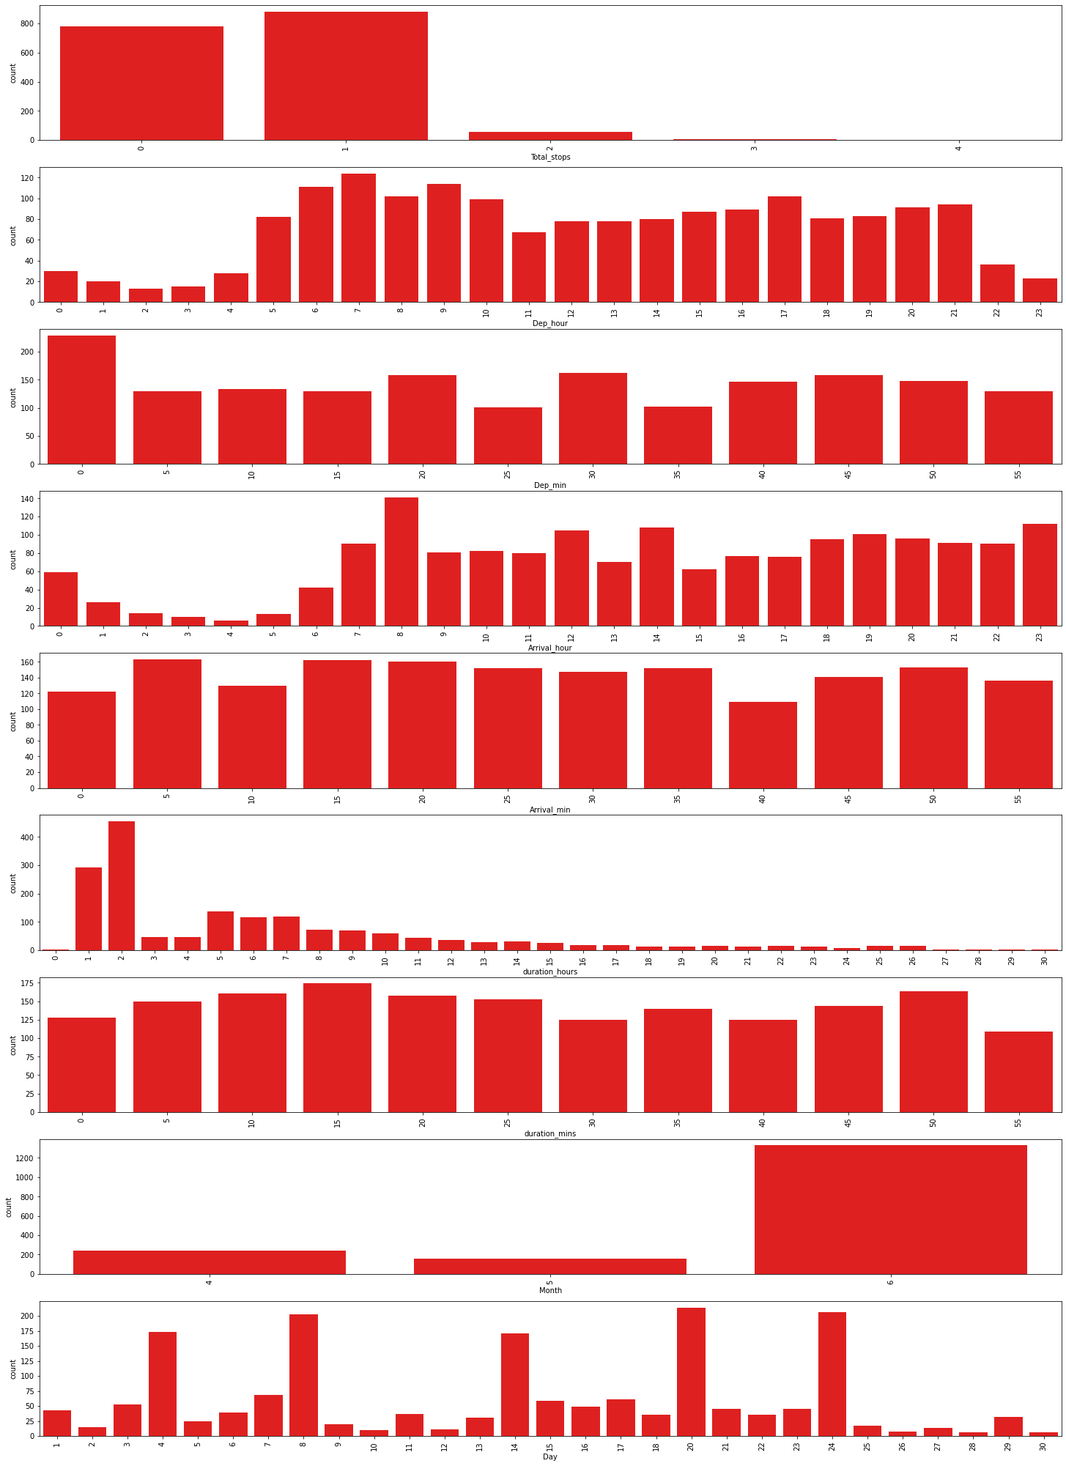
Univariate Analysis of Numerical variables
OBSERVATION:
Most of the flights are having 1 stop followed by no.of non-stop flights.
Departure are maximum durin morning 5am to 9am hour as compared to other time during the day.
Most of the flights take off at 00 mins.
Most of the flights arrive 8am followed by 12pm ,2pm and 11pm hour.
More or less every minutes flights are arriving.
Flights with journey as 2 to 1 hours are maximum.
Flights duration are more or less same during every minutes.
Flights are more in number during the months of June.
Highest no.of flight are on 4th,8th,14th,20th,24th of the month.

Slide 10
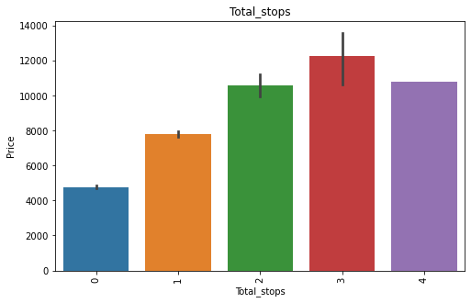
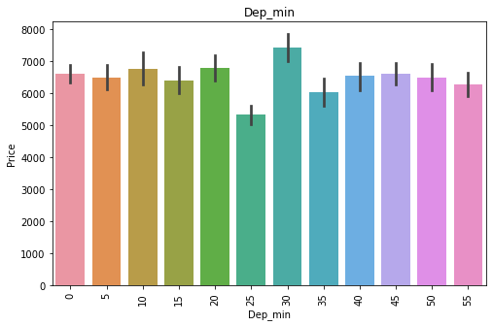
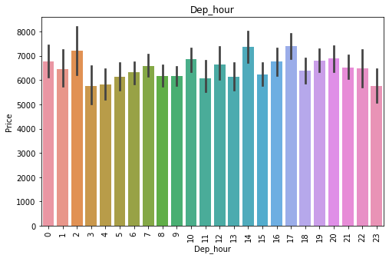
Bi-variate plotting of numerical variables compared with respect to Price
Flights having 3 stops are highest in price followed by 4 stoppage and 2 stoppage flights.
Early morning 1 am , 2pm ands 4 pm departure hour flight are more in price.
At 30 mintues departure the flight price is higher.

Slide 11
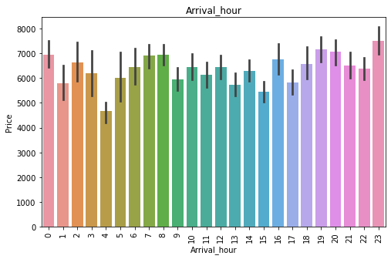
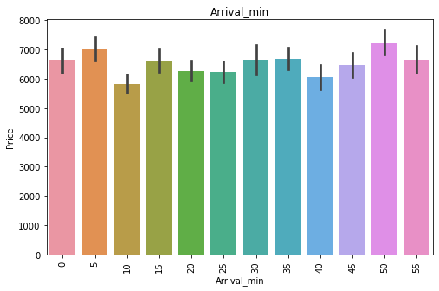
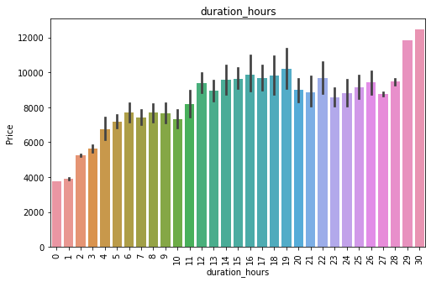
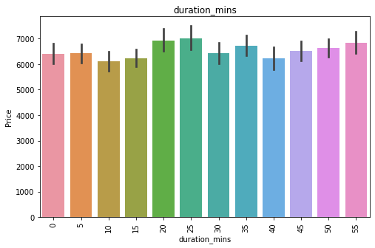
Bi-variate plotting of numerical variables compared with respect to Price
Observation in terms of Price: 4. Night arriving flights are higher is price.
5. Duration is directly proportional to the price, as duration increases flight price also increases.

Slide 12
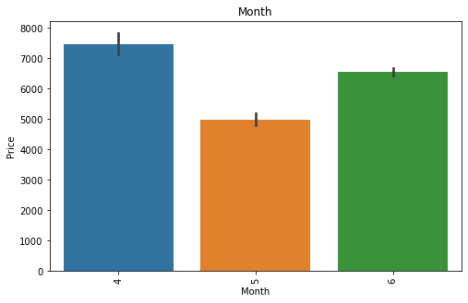
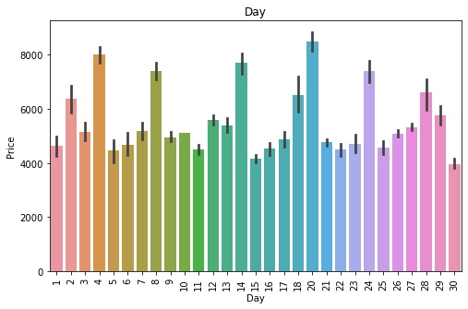
Bi-variate plotting of numerical variables compared with respect to Price
Observation in terms of Price:
6. Flight prices are likely higer in the month of April and June compared to May.
7. Flight prices are higher on some specific date it seems like 4th,8th,14th,20th and 24th.

Slide 13
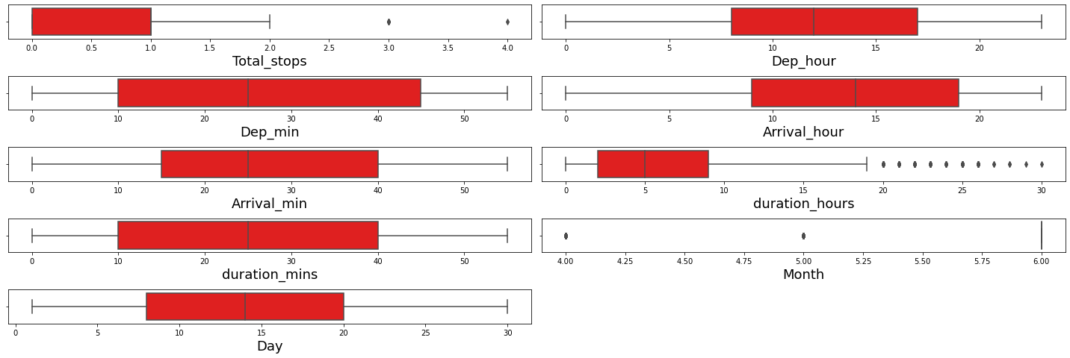
Outliers Detection:
Outliers : Not much of outliers are present in the dataset.

Slide 14
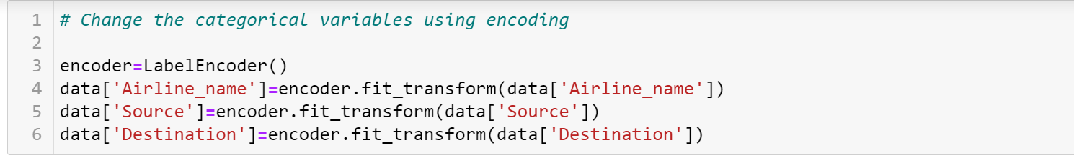
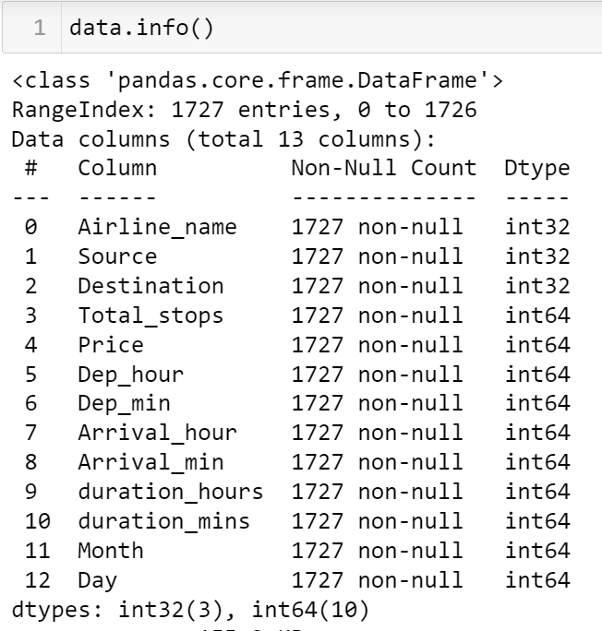
Feature Engineering

Slide 15
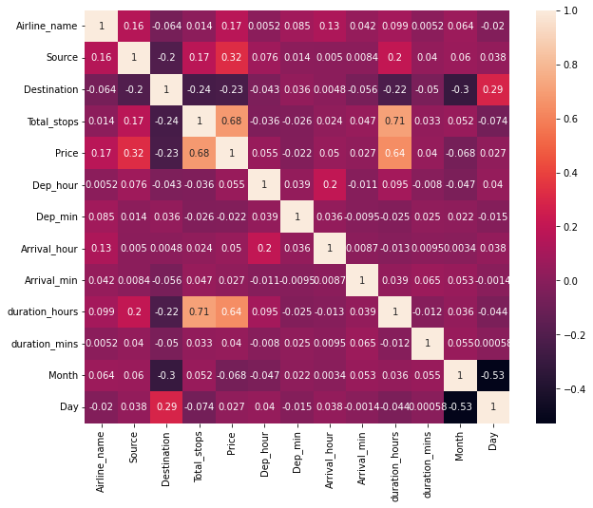
Observation: Total no of stops and duration taken is highly correlated with price.

Slide 16
Models used:
LinearRegression()
DecisionTreeRegressor()
KNeighborsRegressor()
RandomForestRegressor()

Slide 17
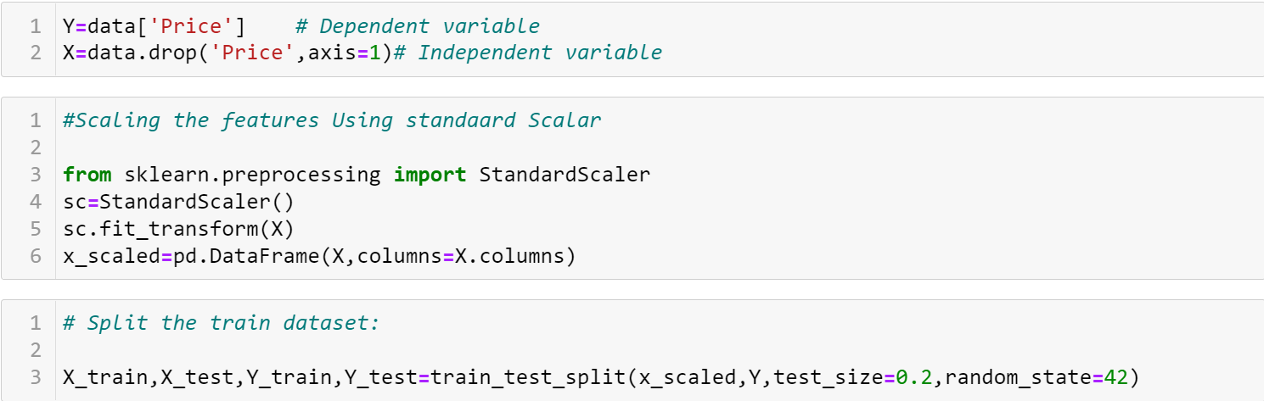
Model Building
From the dataset we can infer that it is clearly a regression problem.

Slide 18
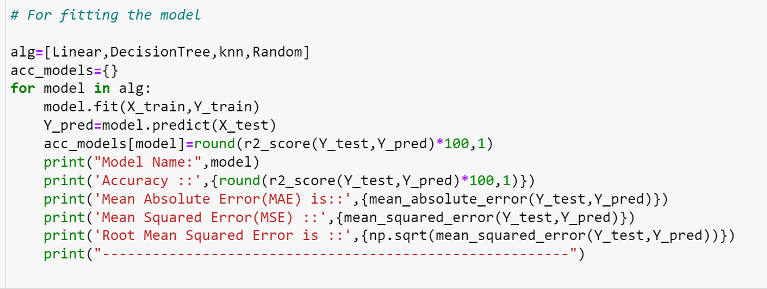
Fitting The Model

Slide 19
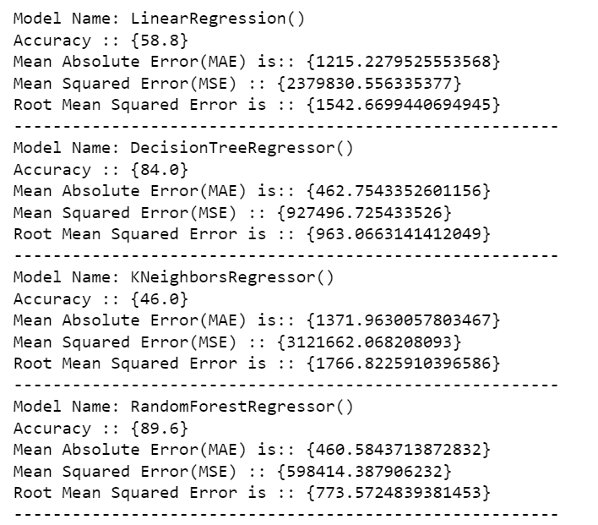
Accuracy of the Following Models

Slide 20
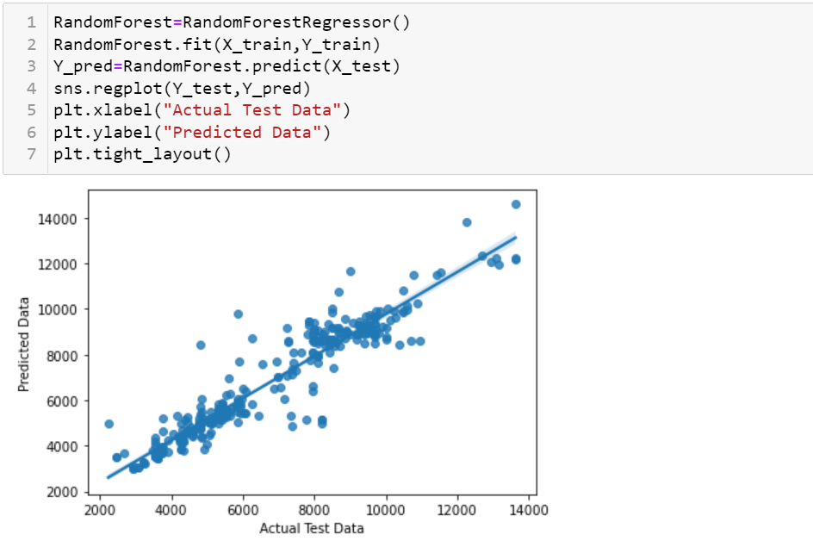
Graph After fitting the model

Slide 21
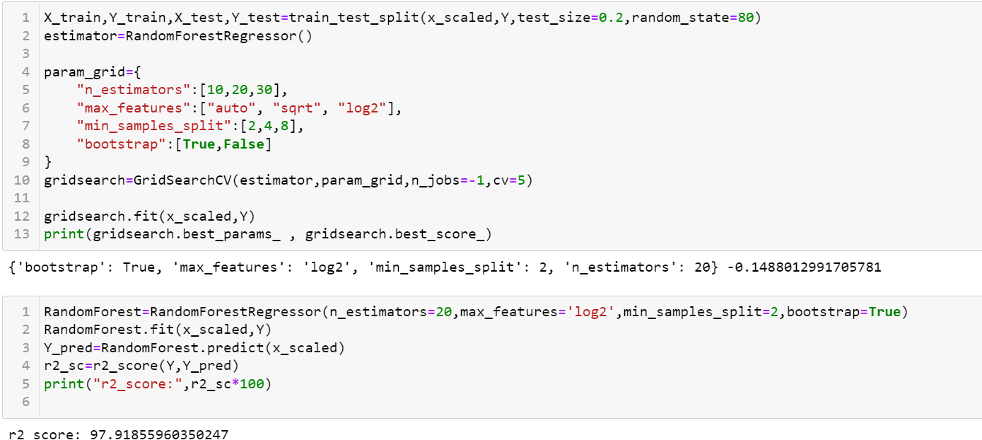
Hyper Tuning the Model

Slide 22
CONCLUSION
FINAL OBSERVATION:
Finally we have saved the Hypertuned Random Forest Regressor Model.

Slide 23


